Slide 1
IT 305
Week 4-Lec 1 TCP Pipelining

Slide 2
rdt3.0: stop-and-wait operation
sender
receiver
L / R
=
L/R
U_{sender}
RTT
+ L / R
.008
RTT
=
30.008
=
0.00027
rdt 3.0 protocol performance stinks!
Protocol limits performance of underlying infrastructure (channel)

Slide 3
Pipelining: increased utilization
sender
receiver
first packet bit transmitted, t = 0
last bit transmitted, t = L / R
first packet bit arrives
RTT
last packet bit arrives, send ACK
last bit of 2nd packet arrives, send ACK
last bit of 3rd packet arrives, send ACK
ACK arrives, send next
packet, t = RTT + L / R
3-packet pipelining increases
utilization by a factor of 3!
Notes:
two generic forms of pipelined protocols: go-Back-N, selective repeat

Slide 4
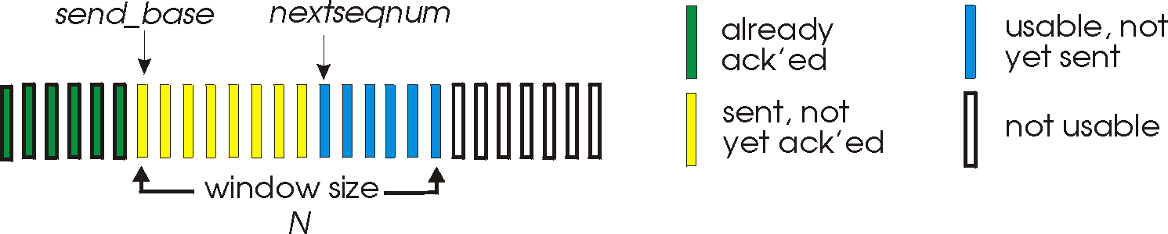
Go-Back-N: sender
sender: “window” of up to N, consecutive transmitted but unACKed pkts
k-bit seq # in pkt header
cumulative ACK: ACK(n): ACKs all packets up to, including seq # n
on receiving ACK(n): move window forward to begin at n+1
timer for oldest in-flight packet
timeout(n): retransmit packet n and all higher seq # packets in window
Notes:
window size of 14, 8 have been sent but are not yet acknowledged, 6 sequence numbers are available for us. In window, but no calls from above to use them.
Note – we’ll skip the Go-Back-N FSM specification you can check that out in PowerPoint slides or book)
TCP uses cumulative ACK

Slide 5
Go-Back-N: receiver
ACK-only: always send ACK for correctly-received packet so far, with highest in-order seq #
may generate duplicate ACKs
need only remember rcv_base
on receipt of out-of-order packet:
can discard (don’t buffer) or buffer: an implementation decision
re-ACK pkt with highest in-order seq #
Receiver view of sequence number space:
received and ACKed
…
…
Out-of-order: received but not ACKed
rcv_base
Not received
Notes:
Note – we’ll skip the Go-Back-N FSM specification (actually it’s

Slide 6

Go-Back-N in action
sender window (N=4)
sender
receiver
0 1 2 3 4 5 6 7 8
send pkt0
send pkt1
send pkt2
send pkt3
(wait)
0 1 2 3 4 5 6 7 8
receive pkt0, send ack0
receive pkt1, send ack1
receive pkt3, discard,
(re)send ack1
0 1 2 3 4 5 6 7 8
X
0 1 2 3 4 5 6 7 8
loss
0 1 2 3 4 5 6 7 8
rcv ack0, send pkt4
0 1 2 3 4 5 6 7 8
rcv ack1, send pkt5
receive pkt4, discard,
(re)send ack1
ignore duplicate ACK
receive pkt5, discard,
(re)send ack1
pkt 2 timeout
0 1 2 3 4 5 6 7 8
send pkt2
send pkt3
send pkt4
send pkt5
0 1 2 3 4 5 6 7 8
0 1 2 3 4 5 6 7 8
rcv pkt2, deliver, send ack2
rcv pkt3, deliver, send ack3
rcv pkt4, deliver, send ack4
rcv pkt5, deliver, send ack5
0 1 2 3 4 5 6 7 8
Notes:
Let’s skip FSM specification for GBN – check out the book or ppt – and let’s watch GBN sender and receivers in action.
Let assume a window size of 4. at t=0, sender sends packets 0, 1, 2 3, 4, and packet 2 will be lost
At the receiver:
Packet 0 received ACK0 generated
Packet 1 received ACK1 generated
Packet 2 is lost, and so when packet 3 is received, ACK 1 is sent – that’s the cumulative ACK, re-Acknowledging the receipt of packet 1. and in this implementation packet 3 is discarded

Slide 7
Selective repeat: the approach
pipelining: multiple packets in flight
receiver individually ACKs all correctly received packets
buffers packets, as needed, for in-order delivery to upper layer
sender:
maintains (conceptually) a timer for each unACKed pkt
timeout: retransmits single unACKed packet associated with timeout
maintains (conceptually) “window” over N consecutive seq #s
limits pipelined, “in flight” packets to be within this window
Notes:
An important mechanism of GBN was the use of the cumulative acknowledgements, and as we mentioned, cumulative ACKs are used in TCP
An alternate ACK mechanism would be for the receiver to individually acknowledge specific packets as they are received. This mechanism is at the heart of the Selective repeat protocol.

Slide 8
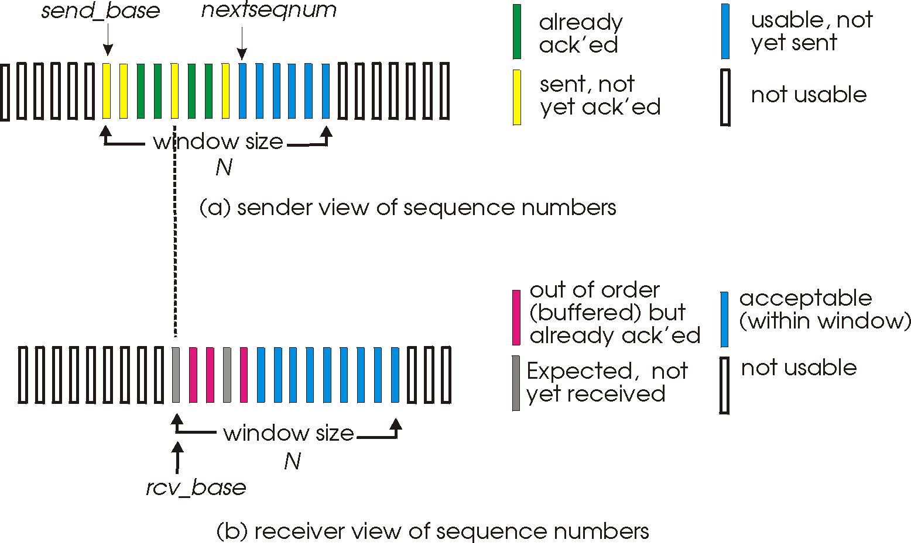
Selective repeat: sender, receiver windows

Slide 9
Selective repeat: sender and receiver
sender
receiver
data from above:
if next available seq # in window, send packet
timeout(n):
resend packet n, restart timer
ACK(n) in [sendbase,sendbase+N-1]:
mark packet n as received
if n smallest unACKed packet, advance window base to next unACKed seq #
packet n in [rcvbase, rcvbase+N-1]
send ACK(n)
out-of-order: buffer
in-order: deliver (also deliver buffered, in-order packets), advance window to next not-yet-received packet
packet n in [rcvbase-N,rcvbase-1]
ACK(n)
otherwise:
ignore
Notes:
If the packet is in order, its data will be delivered, as will any buffered data that can now be delivered in order

Slide 10
Selective Repeat in action
sender window (N=4)
sender
receiver
0 1 2 3 4 5 6 7 8
send pkt0
send pkt1
send pkt2
send pkt3
(wait)
0 1 2 3 4 5 6 7 8
receive pkt0, send ack0
receive pkt1, send ack1
receive pkt3, buffer,
send ack3
0 1 2 3 4 5 6 7 8
X
0 1 2 3 4 5 6 7 8
loss
0 1 2 3 4 5 6 7 8
rcv ack0, send pkt4
0 1 2 3 4 5 6 7 8
rcv ack1, send pkt5
receive pkt4, buffer,
send ack4
record ack3 arrived
receive pkt5, buffer,
send ack5
pkt 2 timeout
0 1 2 3 4 5 6 7 8
send pkt2
(but not 3,4,5)
0 1 2 3 4 5 6 7 8
0 1 2 3 4 5 6 7 8
rcv pkt2; deliver pkt2,
pkt3, pkt4, pkt5; send ack2
0 1 2 3 4 5 6 7 8
Q: what happens when ack2 arrives?

